Slide 1

The Ocean Decade Roadmap for Africa
Opportunities for Harnessing Science for Sustainable Development of Ocean Economy in Africa
Prof AFFIAN, K ./ MIKA, O.

Slide 2
Outline
IOC / UNESCO
IOCAFRICA / GOOS AFRICA
OCEAN DECAD IN AFRICA
ROAD MAP OF AFRICA

Slide 3
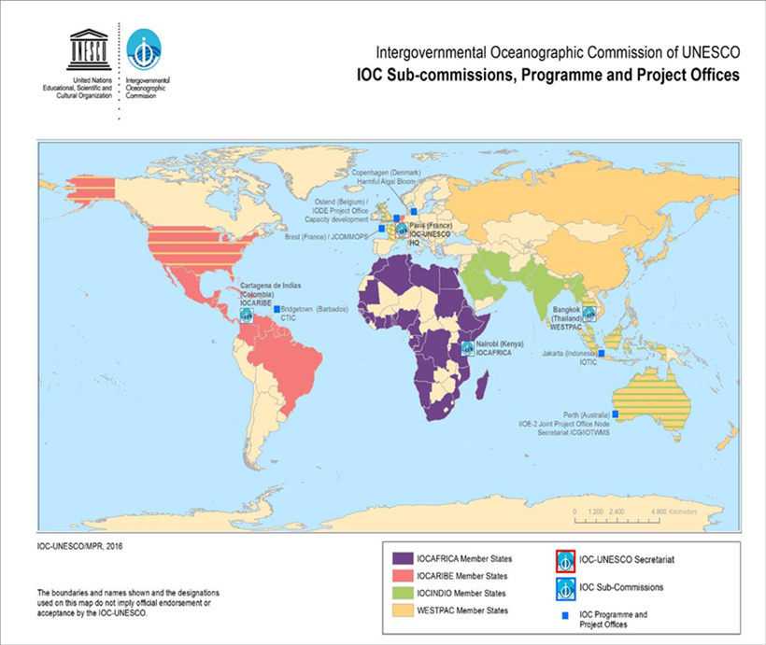
The Intergovernmental Oceanographic Commission
(IOC) of UNESCO, 150 Member States
Intergovernmental body of the UN system for ocean science, observations, data exchange, services, capacity development, and science-to-governance work
IOCAFRICA
WESPAC
IOCARABE
Notes:
Let me start by introducing the Intergovernmental Oceanographic Commission of UNESCO and its programmes.
IOC was established in1960 as the Intergovernmental body of the UN system for ocean science, observations, data exchange, services, capacity development, and science-to-governance work. It has 150 Member States and focuses on the building of scientific knowledge, applying the knowledge for societal benefit, and improving governance.
The IOC’s Sub Commission for Africa and the Adjacent Island States (IOCAFRICA) was established by in 2011 as a framework to facilitate coordination among Member States in the region, and to ensure the efficient implementation of IOC programme in Africa. It’s one of IOC’s three Sub Commissions. The other two cover the Western Pacific (WESTPAC) and the Caribbean and Adjacent regions (IOCARIBE)

Slide 4
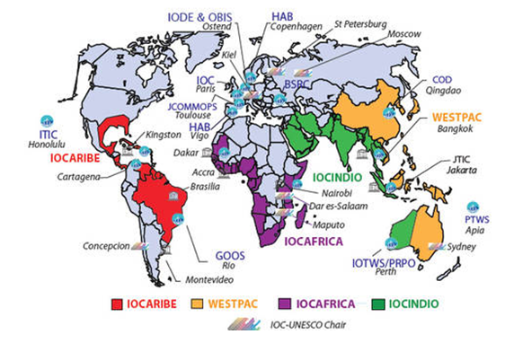
IOCAFRICA WITHIN IOC / UNESCO
Notes:
The IOC’s Sub Commission for Africa and the Adjacent Island States (IOCAFRICA) was established by in 2011 as a framework to facilitate coordination among Member States in the region, and to ensure the efficient implementation of IOC programme in Africa. It’s one of IOC’s three Sub Commissions. The other two cover the Western Pacific (WESTPAC) and the Caribbean and Adjacent regions (IOCARIBE)

Slide 5
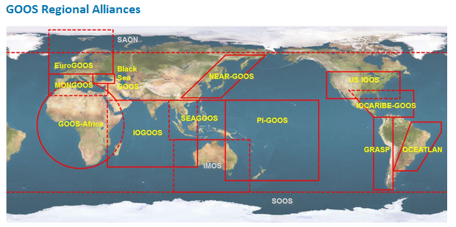
GOOS regional alliances

Slide 6
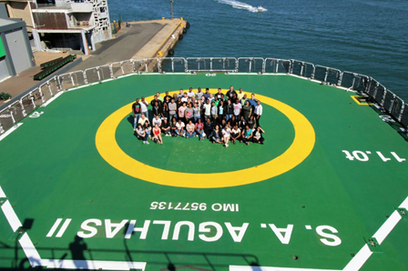
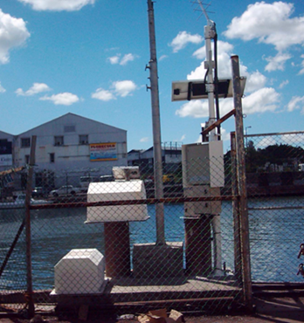
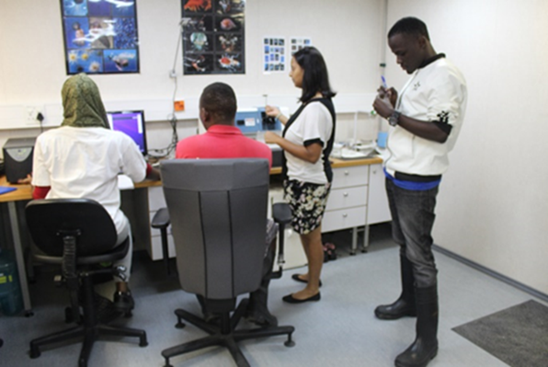
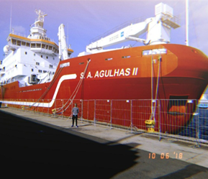
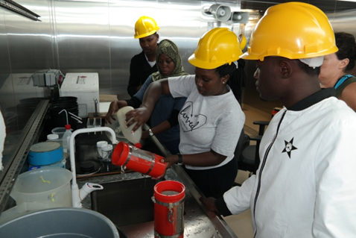
FOCUS AREAS OF IOCAFRICA &GOOS-AFRICA.(1/2)
AFRICA BLUE ECONOMY STRATEGY
PORT AND SHIPPING
FISHERY
AQUACULTURE
SUSTAINABLE BLUE ENERGY
COASTAL TOURSIM
BLUE CARBON AND OTHER ECOSYSTEMS
Ocean Observations and Data and Information Management:
  Oceanographic Expeditions & Coastal Observation platforms
  Climate variability and climate change (weather forecast & extreme events)
  Marine Spatial Planning, Coastal/ Marine Atlases, Marine Biodiversity
Ocean Science and its Application to Management:
  Modeling and forecasts of ocean state
  Assessment of marine and coastal ecosystems in Africa
  Vulnerability & adaptation of marine/coastal ecosystems to climate change
  Harmful Algal Bloom: Detection and Early Warning
  Ocean Acidification: Observation and Research
  Marine Pollution: Survey and assessment
Notes:
IOCAFRICA & GOOS-AFRICA works with partners in the region, including national institutions and regional organizations to support this.
Our programmes can be categorized in the following three broad areas:
Ocean Observations and Data and Information Management
Ocean Science and its Application to Management
Capacity Development for Marine Science and Technology and Ocean Literacy
These contribute to the six themes of the African Unions Blue Economy Strategy: Port and Shipping, Fishery, Aquaculture, Sustainable Blue Energy, Coastal Tourism and Blue Carbon and other ecosystems.

Slide 7
FOCUS AREAS OF IOCAFRICA &GOOS-AFRICA.(1/2)
AFRICA BLUE ECONOMY STRATEGY
PORT AND SHIPPING
FISHERY
AQUACULTURE
SUSTAINABLE BLUE ENERGY
COASTAL TOURSIM
BLUE CARBON AND OTHER ECOSYSTEMS
Capacity Development for Marine Science and Technology and Ocean Literacy:
  Basic training in the ocean sciences (UNESCO Chairs in Universities, Research Institutions, development of portal for training opportunities,)
  Continuous Professional Development (Focused workshops, Regional Training Centres, Fellowships,
  Ocean Literacy (Artwork/Essay competitions, exhibitions, conferences,
  Partnerships and collaboration (WIOMSA, UNEP, National Institutions)
Notes:
IOCAFRICA works with partners in the region, including national institutions and regional organizations to support this.
Our programmes can be categorized in the following three broad areas:
Ocean Observations and Data and Information Management
Ocean Science and its Application to Management
Capacity Development for Marine Science and Technology and Ocean Literacy
These contribute to the six themes of the African Unions Blue Economy Strategy: Port and Shipping, Fishery, Aquaculture, Sustainable Blue Energy, Coastal Tourism and Blue Carbon and other ecosystems.

Slide 8

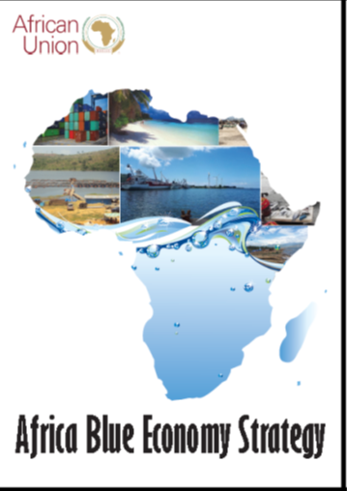
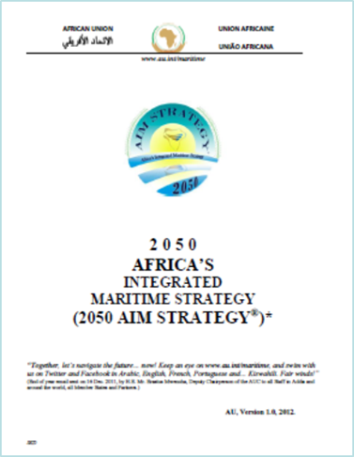
Ocean Decade in Africa
Coastal and ocean waters in Africa are increasingly gaining importance as a potential source of economic growth and employment
Clear links and synergies with other regional frameworks, e.g.
  Decade of African Seas and Oceans (2015-2025)
  African Union Agenda 2063: ‘The Africa We Want’
  205Africa’s Integrated Maritime Strategy (2050 AIM Strategy)
  Africa Blue Economy Strategy (2019)
Notes:
The Ocean Decade is especially important for Africa as its coastal and ocean waters are increasingly gaining importance as a potential source of economic growth and employment
In developing a regional Ocean Decade Roadmap for Africa, it is important to have clear links and synergies with other regional frameworks, in particular:
Decade of African Seas and Oceans (2015-2025)
African Union Agenda 2063: ‘The Africa We Want’
2050 Africa’s Integrated Maritime Strategy (2050 AIM Strategy)
Africa Blue Economy Strategy (2019)

Slide 9
Regional Consultations on the UN Decade of Ocean Science for Sustainable Development (2021-2030) for Africa and the Adjacent Island States, 27-29 January 2020, Nairobi, Kenya.
Collaboration with UNEP, WIOMSA, GIZ, CORDIO, SCOR
Harnessing the demographic dividend by empowering the huge pool of youthful population. The focus should be on getting them into ocean sciences through focused ocean literacy programmes, supporting skills development and mentoring to enable them fit in the job market and creating new opportunities for employment.
The Decade should catalyse research in the following fields: marine renewable energy and deep ocean water applications; bioprospecting, biotechnology and pharmaceuticals; mariculture and offshore aquaculture; climate change impacts and the oceans-climate nexus; baseline monitoring of essential ocean variables; mapping ecosystems and habitats; and linking the research results to societal applications.
Improving the quality and quantity of research outputs. Scientists and institutions should think beyond producing publications to transforming lives through innovation and robust application of ocean science.
Ocean research in the region should be strengthened through stronger integration of sciences, greater investment in ocean observing systems and improved science-policy interface. New partnerships should be developed, supported by a new ocean-climate finance, and improved ocean literacy and education to modify social norms and behavior...
Establishment of university-based ocean innovation incubator hubs, supported by the private sector, to serve as a conduit to transform research results to action via technological development that is adapted to regional and local contexts and led by African researchers.
Notes:
Five recommendations were made during the regional consultations on the Decade:
The need to harness the demographic dividend by empowering the huge pool of youthful population through focused ocean literacy programmes, supporting skills development and mentoring to enable them fit in the job market and creating new opportunities for employment.
The need to catalyze research in key ocean related fields and link the research results to societal applications.
The importance of improving the quality and quantity of research outputs and using them to transform lives through innovation and robust application of ocean science.
Strengthening ocean research in the region through stronger integration of sciences, greater investment in ocean observing systems and improved science-policy interface.
And finally establishment of university-based ocean innovation incubator hubs, to serve as a conduit to transform research results to action via technological development that is adapted to regional and local contexts and led by African researchers.

Slide 10
Identification of Priorities, Gaps and Needs
Mapped to the Ocean Decade Challenges

Slide 11



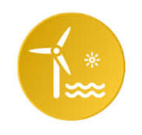
Ocean Decade Challenge | Scope of the Challenges relevant to Africa
1. Understand and beat marine pollution | Understanding causes and impacts of the decline of water quality due to marine litter and micro plastics, oil spills, chemical pollution and eutrophication Identifying multi-stressor hotspots
2. Protect and restore ecosystems and biodiversity | Understanding healthy and resilient marine ecosystems Biodiversity, including species diversity and taxonomy Alien and invasive species Structure and functioning of the ocean Linkages between ecosystem services and people
3. Sustainably feed the global population | Fisheries and aquaculture, including data, assessments, ecosystem-based approach to fisheries management, enforcement and governance
4. Develop a sustainable and equitable ocean economy | Ocean science in support of the development of a sustainable ocean economy, including data and observations, evaluation of environmental change scenarios

Slide 12



Ocean Decade Challenge | Scope of the Challenges relevant to Africa
5. Unlock ocean-based solutions to climate change | Trends/changes in environmental conditions and long-term monitoring Numerical modelling, forecasting, indicators Impacts on marine ecosystems Climate processes at local and regional scales, and for different time scales
6. Increase community resilience to ocean hazards | Early warning systems for ocean-related hazards and extreme events, including vulnerability to flooding, enhanced frequency and duration of tropical cyclones, storm surges, tsunamis etc.
7. Expand the global ocean observing system | Ocean observations and monitoring Modelling and forecasting of ocean processes and ecosystems, including coupled ocean-atmosphere models Ocean data and information management Emerging technologies for ocean observations and monitoring

Slide 13



Ocean Decade Challenge | Scope of the Challenges relevant to Africa
8. Create a digital representation of the ocean | Digital representation of the ocean, mapping of the ocean floor in Africa including a dynamic ocean map
9. Skills knowledge and technology for all | Ocean training, research capacities and opportunities Equitable access to data, information, knowledge and technology Transformative partnerships for the sustainable development of oceans
10. Change humanity’s relationship with the ocean | Improved ocean literacy and better communication to improve humanity’s relationship with the ocean, recognition and better understanding of the multiple values of the ocean for human well-being, culture and sustainable development
Cross-cutting themes | Marine spatial planning (MSP) and integrated coastal zone management (ICZM) Ocean science-policy interface Ocean governance, including Areas Beyond National Jurisdiction (ABNJ)

Slide 14
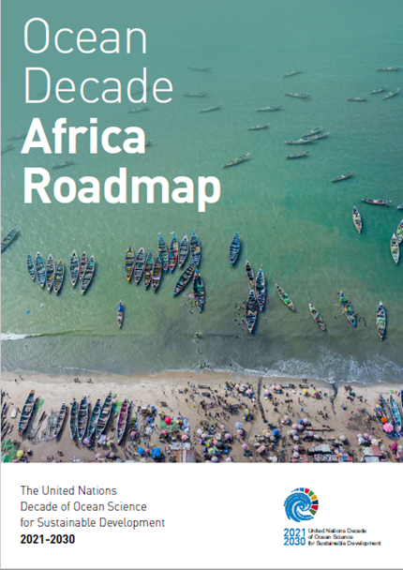
Africa Roadmap: Purpose and Structure
The Ocean Decade Africa Roadmap provides a vision and plan for diverse stakeholders from government, industry, philanthropy, UN agencies, civil society and the scientific community, to convene around a common set of priorities for the implementation of the Ocean Decade in Africa.
The aims of the Africa Roadmap are to:
  provide a coordinated and optimized framework for ocean science planning and delivery
  enhance coordination between agencies and build synergies between research initiatives, and users of ocean science and knowledge
  provide a foundation to monitor the achievement of priorities and outcomes
https://unesdoc.unesco.org/ark:/48223/pf0000381488

Slide 15

Nine Priority Future Decade Actions
1. Sustainable ocean management in Africa
2. Ocean and human health in Africa
3. Unlocking the blue carbon potential of Africa
4. Fisheries and IUU in Africa
5. Strengthening multi-hazard early warning systems and community resilience
6. Ocean observations and forecasting systems for Africa
7. Digital twin for Africa - Establishing an African ocean knowledge hub
8. Strengthening capacities and skills of African Early Career Ocean Professionals (ECOPs)
9. Regional ocean literacy programme for Africa
AGENDA 2063: Recognizes that Africa’s Blue economy shall be a major contributor to continental transformation and growth, advancing knowledge on marine and aquatic biotechnology, the growth of an Africa-wide shipping industry, the development of sea, river and lake transport and fishing; and exploitation of and beneficiation from deep sea mineral and other resources
AFRICA BLUE ECONOMY STRATEGY
PORT AND SHIPPING
FISHERY
AQUACULTURE
SUSTAINABLE BLUE ENERGY
COASTAL TOURSIM
BLUE CARBON AND OTHER ECOSYSTEMS
Notes:
At the heart of the Africa Roadmap are the nine Priority Future Decade Actions:
1. Sustainable ocean management in Africa
2. Ocean and human health in Africa
3. Unlocking the blue carbon potential of Africa
4. Fisheries and IUU in Africa
5. Strengthening multi-hazard early warning systems and community resilience
6. Ocean observations and forecasting systems for Africa
7. Digital twin for Africa - Establishing an African ocean knowledge hub
8. Strengthening capacities and skills of African Early Career Ocean Professionals (ECOPs)
9. Regional ocean literacy programme for Africa

Slide 16
Enabling Environment
Capacity development (e.g. ECOPs)
Equitable and inclusive partnerships (intra-, inter-regional, including with African diaspora)
Gender and Indigenous and Local Knowledge (ILK)
Resource mobilization
Coordinated and effective implementation of the Roadmap
  The Ocean Decade Africa Roadmap serves as a call for African organization and individual champions to take the initiative and lead the co-design and co-delivery of Decade Actions to tackle the pressing challenges in Africa.
Notes:
The Ocean Decade Africa Roadmap serves as a call for African organization and individual champions to take the initiative and lead the co-design and co-delivery of Decade Actions to tackle the pressing challenges in Africa.
This will require an enabling environment that comprises:
The need for Capacity development
Partnerships (intra-regional, i.e. between African organizations; inter-regional i.e. with other organizations outside Africa, including with African diaspora)
Gender and Indigenous and Local Knowledge (ILK) as a very important component in the co-design and co-delivery on Actions
Resource mobilization – way to close the gap in limited resources

Slide 17

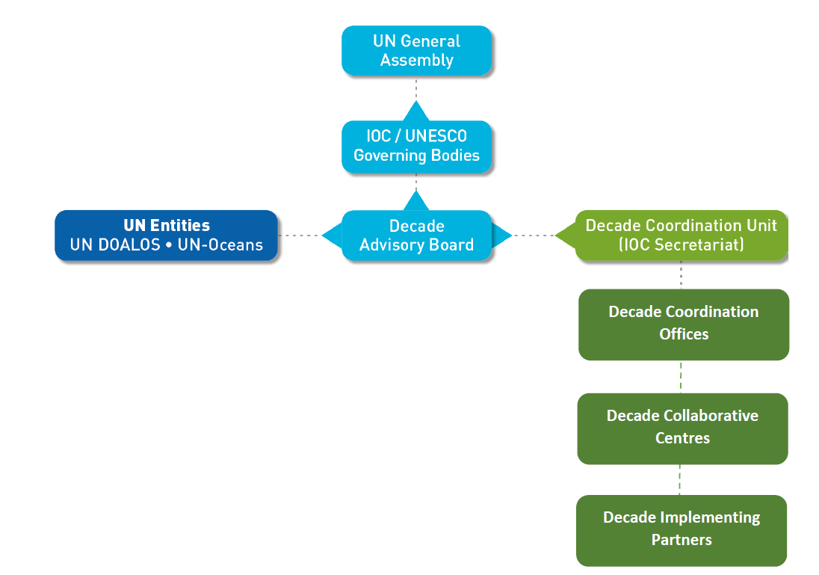
Governance & Coordination Structures
African Ocean Decade Task for Africa
Resource mobilization for IOCAFRICA as African DCO / regional coordination hub
National Ocean Decade Comm
African and adjacent island states represented on Board – 3 of 15 experts
Thematic DCCs relevant to African initiatives
Regional / thematic DIPs throughout Africa (e.g. NIOF in Egypt)
Notes:
Implementation of the Ocean Decade Africa Roadmap will require strong coordination at the national, regional and international levels
Coordination and collaboration will need to occur both thematically and geographically
Multiple stakeholders need to be engaged in governance and coordination structures

Slide 18
THANK YOU FOR YOUR ATTENTION

